Slide 1
German Election System
Maisa Ben Salah & Yecine Megdiche
07.02.2021
1

Slide 2
ARCHITECTURE OVERVIEW
2

Slide 3


ARCHITECTURE OVERVIEW
2

Slide 4


ARCHITECTURE OVERVIEW
2

Slide 5


ARCHITECTURE OVERVIEW
2

Slide 6
ARCHITECTURE OVERVIEW
REST
2

Slide 7
ARCHITECTURE OVERVIEW
SQL
REST
2

Slide 8

ARCHITECTURE OVERVIEW
SQL
REST
2

Slide 9


ARCHITECTURE OVERVIEW
SQL
REST
2

Slide 10
DEMO
3

Slide 11
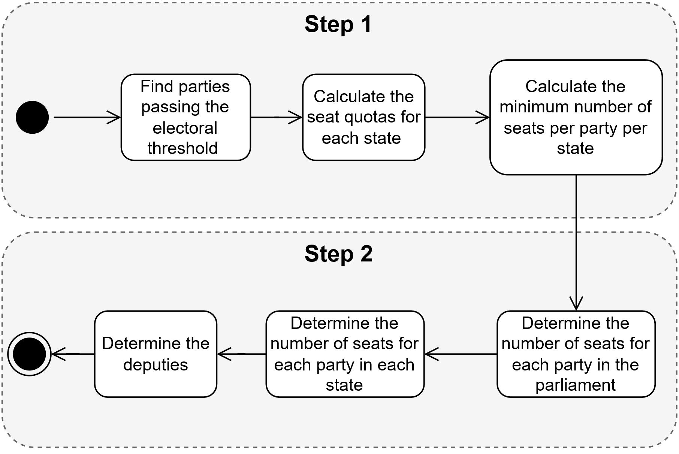
Seat Distribution
4

Slide 12
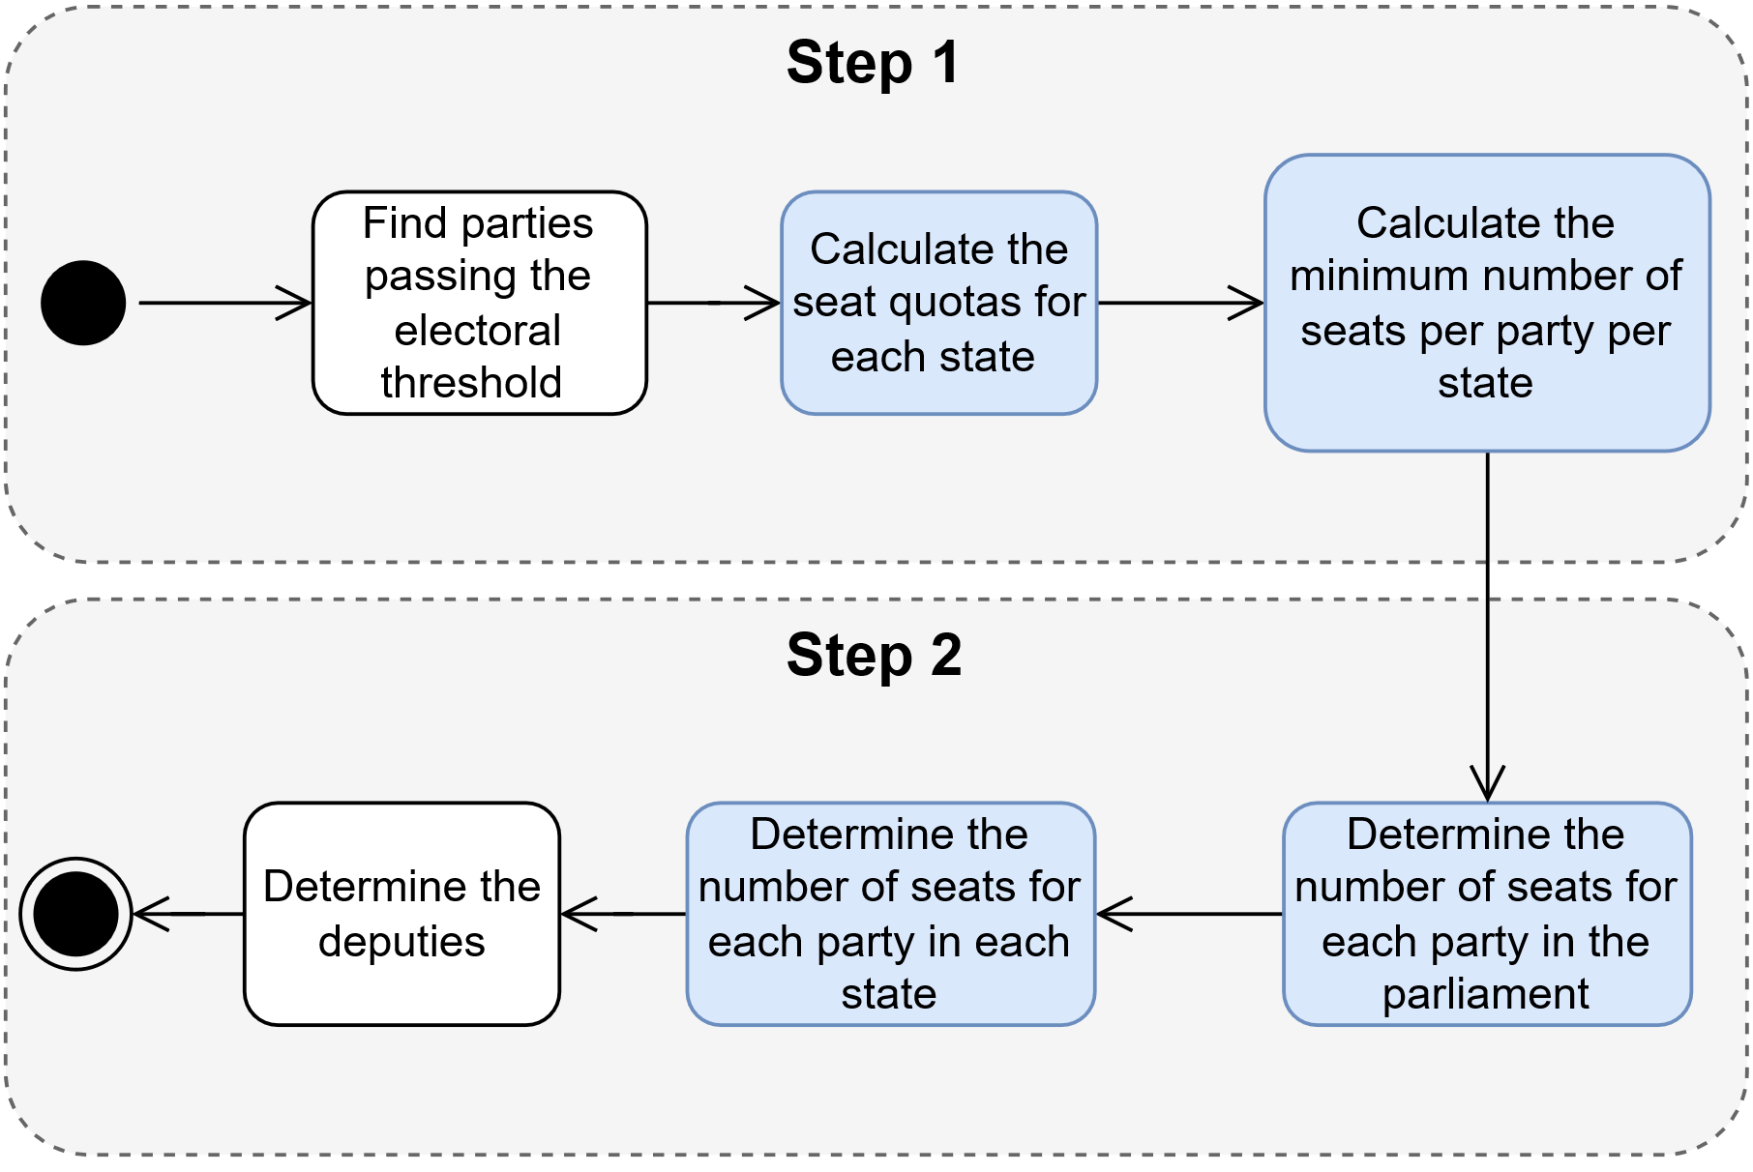
Seat Distribution
4

Slide 13
Seat Distribution
Sample Sainte-Laguë Implementation
Task: Distribute n seats over parties.
Algorithm: Highest averages method (Höchstzahlverfahren):
5

Slide 14
Seat Distribution
Sample Sainte-Laguë Implementation
Task: Distribute n seats over parties.
Algorithm: Highest averages method (Höchstzahlverfahren):
Divide the votes for each party by 0,5; 1,5; …; n – 0,5
WITH h AS (
SELECT party,
votes / (s.a – 0.5) AS ratio
FROM total,
generate_series(1, n) AS s(a)
)
5

Slide 15
Seat Distribution
Sample Sainte-Laguë Implementation
Task: Distribute n seats over parties.
Algorithm: Highest averages method (Höchstzahlverfahren):
Divide the votes for each party by 0,5; 1,5; …; n – 0,5
Sort the previous results and give seats to the first n ratios.
WITH h AS (
SELECT party,
votes / (s.a – 0.5) AS ratio
FROM total,
generate_series(1, n) AS s(a)
ORDER BY ratio DESC
LIMIT n
)
5

Slide 16
Seat Distribution
Sample Sainte-Laguë Implementation
Task: Distribute n seats over parties.
Algorithm: Highest averages method (Höchstzahlverfahren):
Divide the votes for each party by 0,5; 1,5; …; n – 0,5
Sort the previous results and give seats to the first n ratios.
Count the number of seats per party
WITH h AS (
SELECT party,
votes / (s.a – 0.5) AS ratio
FROM total,
generate_series(1, n) AS s(a)
ORDER BY ratio DESC
LIMIT n
)
SELECT party, COUNT(*) as total_seats
FROM h
GROUP BY party
5

Slide 17

Benchmark
Test Number | Number of users | Wait-time (seconds) | Number of Requests | Requests per second | Average response time (ms)
0 (Baseline) | 1 | 1 | 452 | 1.51 | 18
1 | 100 | 5 | 8950 | 29.86 | 27
2 | 100 | 1 | 43815 | 146.13 | 17
3 | 500 | 5 | 44619 | 148.82 | 41
4 | 500 | 1 | 51515 | 171.84 | 2221
All tests ran a total of five minutes (CPU: Intel i7-8750H (12) @ 4.100GHz, RAM: 12GB), OS: Manjaro Linux x86_64, 4.19.217-1-MANJARO).
6

Slide 18
Thank you for your attention
7

